Slide 1

Creating Movies with Captured Raw Video
Featuring
Storyboards
Digital Video Cameras
Moviemaker

Slide 2
Phase One - Planning
Collaborate with your group
  Pick movie topic
  Decide on each member’s tasks
Topics
  Must have beginning, middle, end
  Transfer details to Storyboard template

Slide 3
Acceptable Topics
Describe benefits of taking a business class in general
Promote a particular business class
Describe/promote FBLA – why join
Sell a product
  (MUST BE APPROPRIATE FOR SCHOOL)
Other suggestions? Must get approved first!

Slide 4
Choosing Member Tasks
1 Primary camera person
  Responsible for getting/returning equipment
1 Primary video capture person
  Only group member to capture the video
1 music editor
  Find/edits music
2-3 actors
  Should assist others in production

Slide 5
Evaluating Group Members
Mrs. Kirtland will evaluate each person’s participation in group
Each group member will anonymously evaluate each member
Each member will receive same grade
  Unless proven not to have been involved
  Absences may be a problem

Slide 6
Phase Two - Filming
Learn about the video cameras
  What NOT to do
  How to use the camera’s controls
    Zoom
    Start, stop, rewind, play
  How to use the tripod or
    How to keep the camera steady without a tripod
Camera persons must meet with Mrs. Kirtland

Slide 7
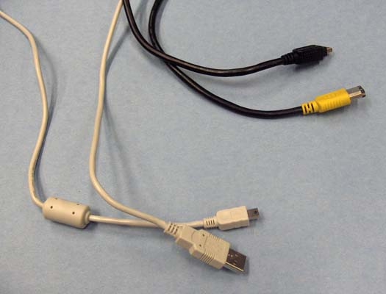
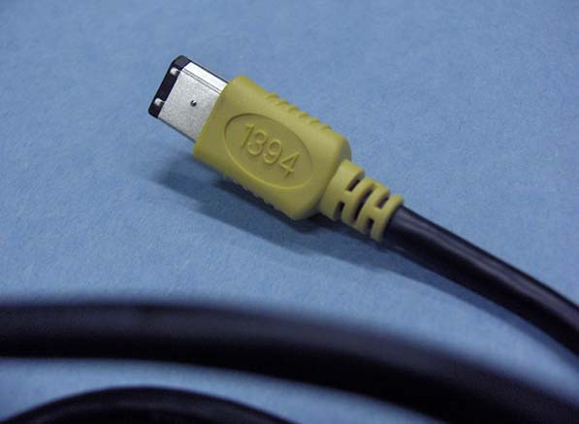
Firewire vs USB Connection During Capture
We have Firewire cables but no
Firewire cards
Firewire – 1394 EEE
Faster/better
USB – Does not require a special card

Slide 8
Phase Three – Capturing/Editing
4 cameras are available for recording
  Cannon, Panasonic, Flip
3 cameras connect directly to the computer via USB (Panasonic and Flip)
Cannon requires a Firewire connection that we do not have

Slide 9
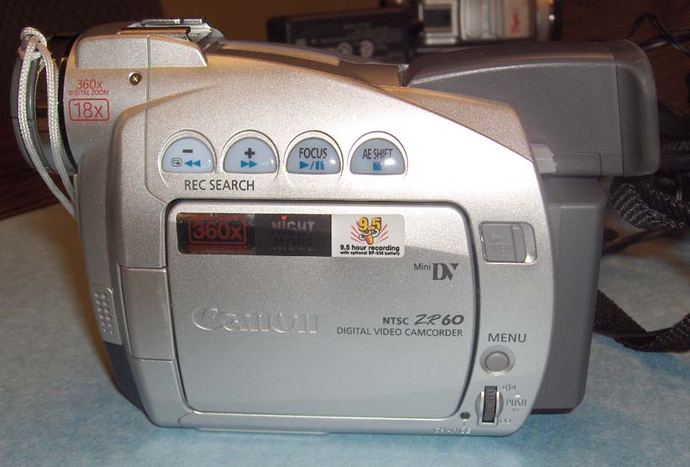
Canon Camcorder
Uses digital tape
Very intuitive
Tape loads from bottom

Slide 10
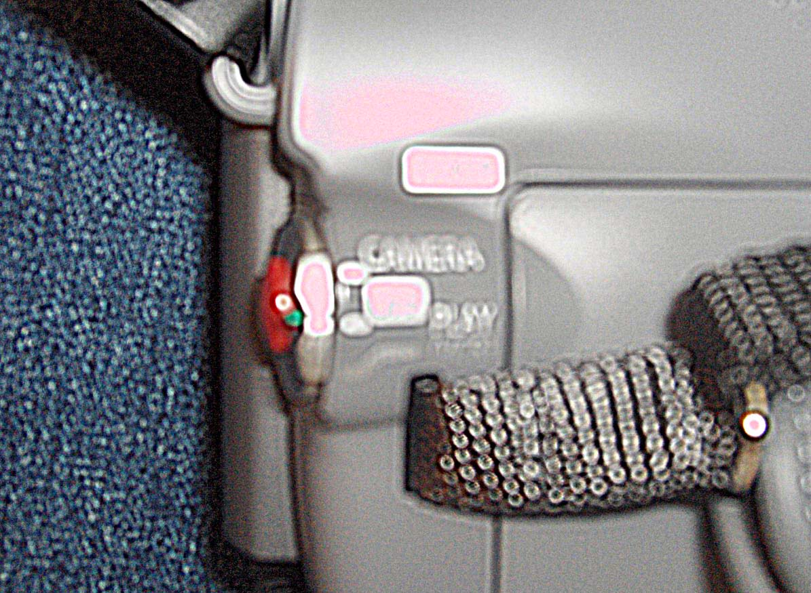
Canon - Recording
Slide green button to Camera Mode
Slide green button to Play Mode
to view
Press red button to start/stop recording

Slide 11
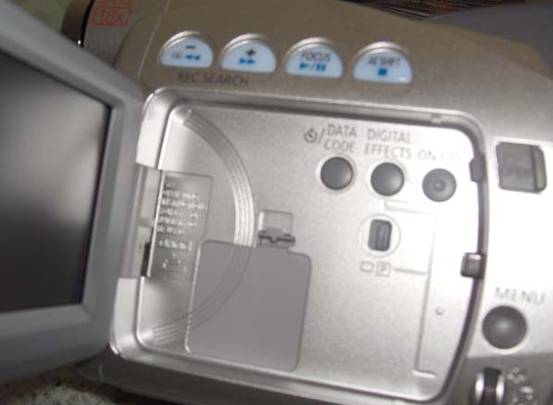
Canon – Inside Controls
Fast Forward
Rewind
Stop
Play

Slide 12
Canon – Capturing Video
Remove mini-cassette from Canon
Insert into Panasonic camera
Be sure camera is off when you connect
Connect Panasonic to Capture Editor’s computer via USB
Must use DC power (not battery)
Use Moviemaker to capture video
Be sure you safely close USB connection before you turn camera off and disconnect USB!!!!!

Slide 13
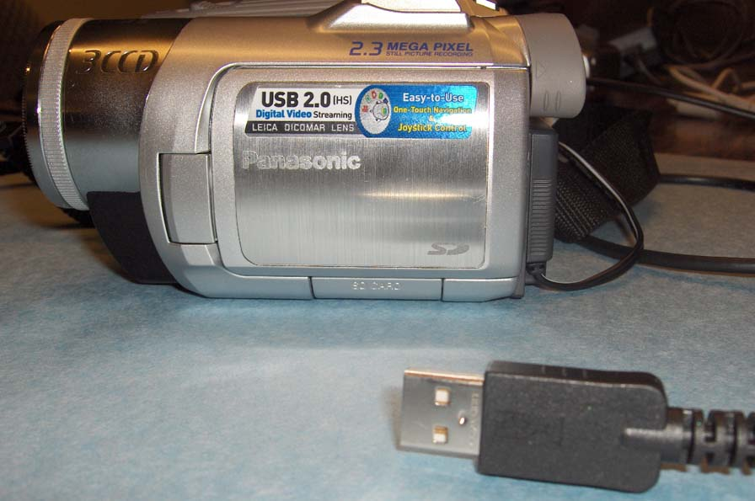
Panasonic Camcorder
Supports
USB capture

Slide 14
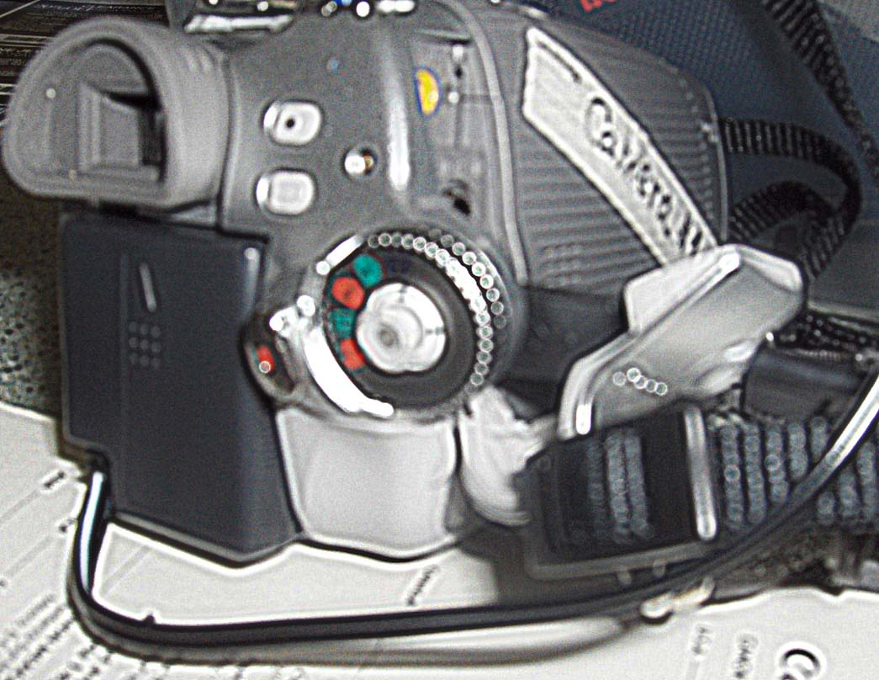
Panasonic - Recording
To playback:
Set Camera control to Green Arrow
just above Red Video
To record:
Set Camera control to Red Video - Bottom Red Button

Slide 15
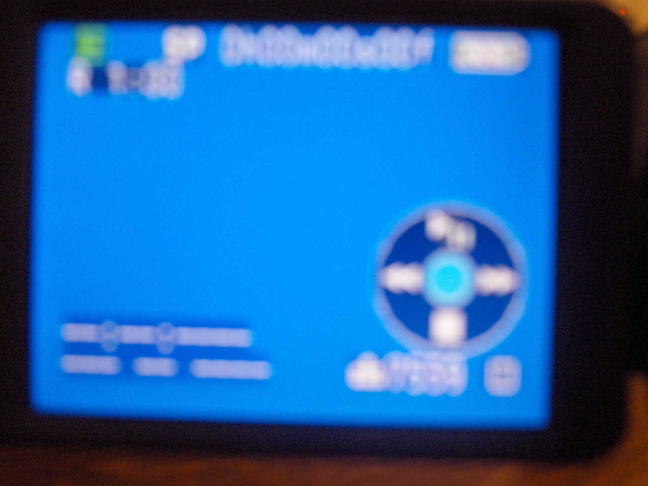
Panasonic – Inside Controls
Use outside
control like
a mini-joystick
Play/Pause
Forward Advance
Rewind
The controls
appear on the
LCD screen
Stop

Slide 16
Panasonic – Capturing Video
Be sure camera is off when you connect
Connect Panasonic to Capture Editor’s computer via USB
Must use DC power (not battery)
Use Moviemaker to capture video
Be sure you safely close USB connection before you turn camer off and disconnect USB!!!!!

Slide 17
Choosing Camera
All cameras record equally well
Only Panasonic has USB connection to all computers in classroom
If you record on a mini-tape, you will need to use the Panasonic to capture video from camera to computer
Camera choices are 1st come 1st serve
Camera person must check out and check in the cameras with me personally

Slide 18
Get Started
Meet in groups today
Decide topic
Pick tasks for each member and record on D6 Task List
Use Storyboard to plan movie
  Beginning
  Middle
  End
  Music
Know limitations:
  Total movie cannot exceed 1 min 30 sec

Slide 19
Get Storyboard Approved ASAP
No cameras given out until storyboard has been approved
Will definitely be on the 3rd quarter grade
Estimate no more than 3 weeks to complete

